Slide 1


Eric Mayton
Chief Executive Officer
Enabling the Future of Scientific Research
Delivering Innovation to Researchers When and Where They Need It
2026 Product Offerings & Price List
Eric Mayton
Chief Executive Officer

Slide 2

Today’s Presentation
2026 Products & Pricing
Product Line Updates
2026 Pricing
Resources & Support
Updated Partner Portal
Commercial Considerations
Follow Up Meeting Request
Late October or Early November
2025 Cerillo - Confidential and Proprietary

Slide 3

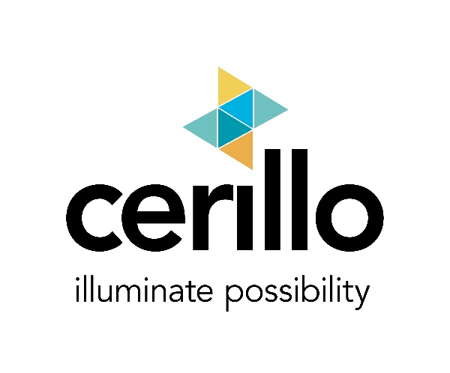


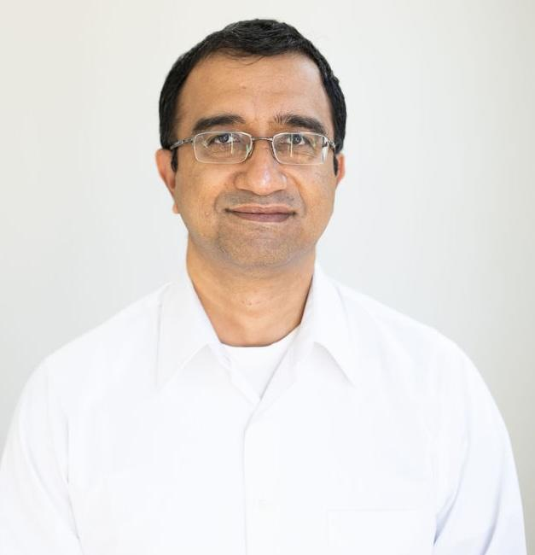
Welcome to the 2026 Product & Pricing Review
Committed to advancing scientific discovery through the development of cutting-edge tools for cellular research.
Mission: Make these tools more accessible to researchers across a wide range of disciplines, enabling new insights and accelerating the pace of discovery.
Meet Your
Cerillo Team
Innovative Life Sciences Technology Company
Headquartered in Charlottesville, VA
Founded in 2016
Commercialization began in 2021
Eric Mayton
Chief Executive Officer
Maulik Oza
VP, Commercial
2025 Cerillo - Confidential and Proprietary

Slide 4






















Traction To Date
880+ Hardware Installs
900+ Consumables Sold
80+ Publication Citations
Customers in 30+ countries
Academic & Government
Industry
2025 Cerillo - Confidential and Proprietary

Slide 5
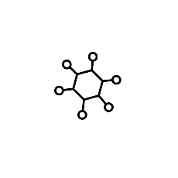

WHAT’S NEW? Big Changes for 2026
Cerillo’s Cellular Discovery Platform:
More than microbial
Microplate Reader Product Line: The Rayo
Duet Co-Culture Product Line:
Cost & Mammalian Cell Culture
Multiple wavelengths
Automation integration models
ALTO is now RAYO S600
New Duets for mammalian culture
Reduced cost for 0.2µ product line
Minimum order quantity enforced
2025 Cerillo - Confidential and Proprietary

Slide 6
WHAT’S THE SAME? Carried over from 2025
Cerillo is your trusted partner for cellular analytics solutions
Microplate Reader Product Line
Duet Co-Culture Product Line
Cost for RAYO S600 remains the same
Adapters available for all RAYO models
Phage Duet price remains the same
Same SKU formats (plates, refills, bundles, & samples)
Labrador Premium & Canopy
Works with all RAYO models
No changes to pricing
2025 Cerillo - Confidential and Proprietary

Slide 7

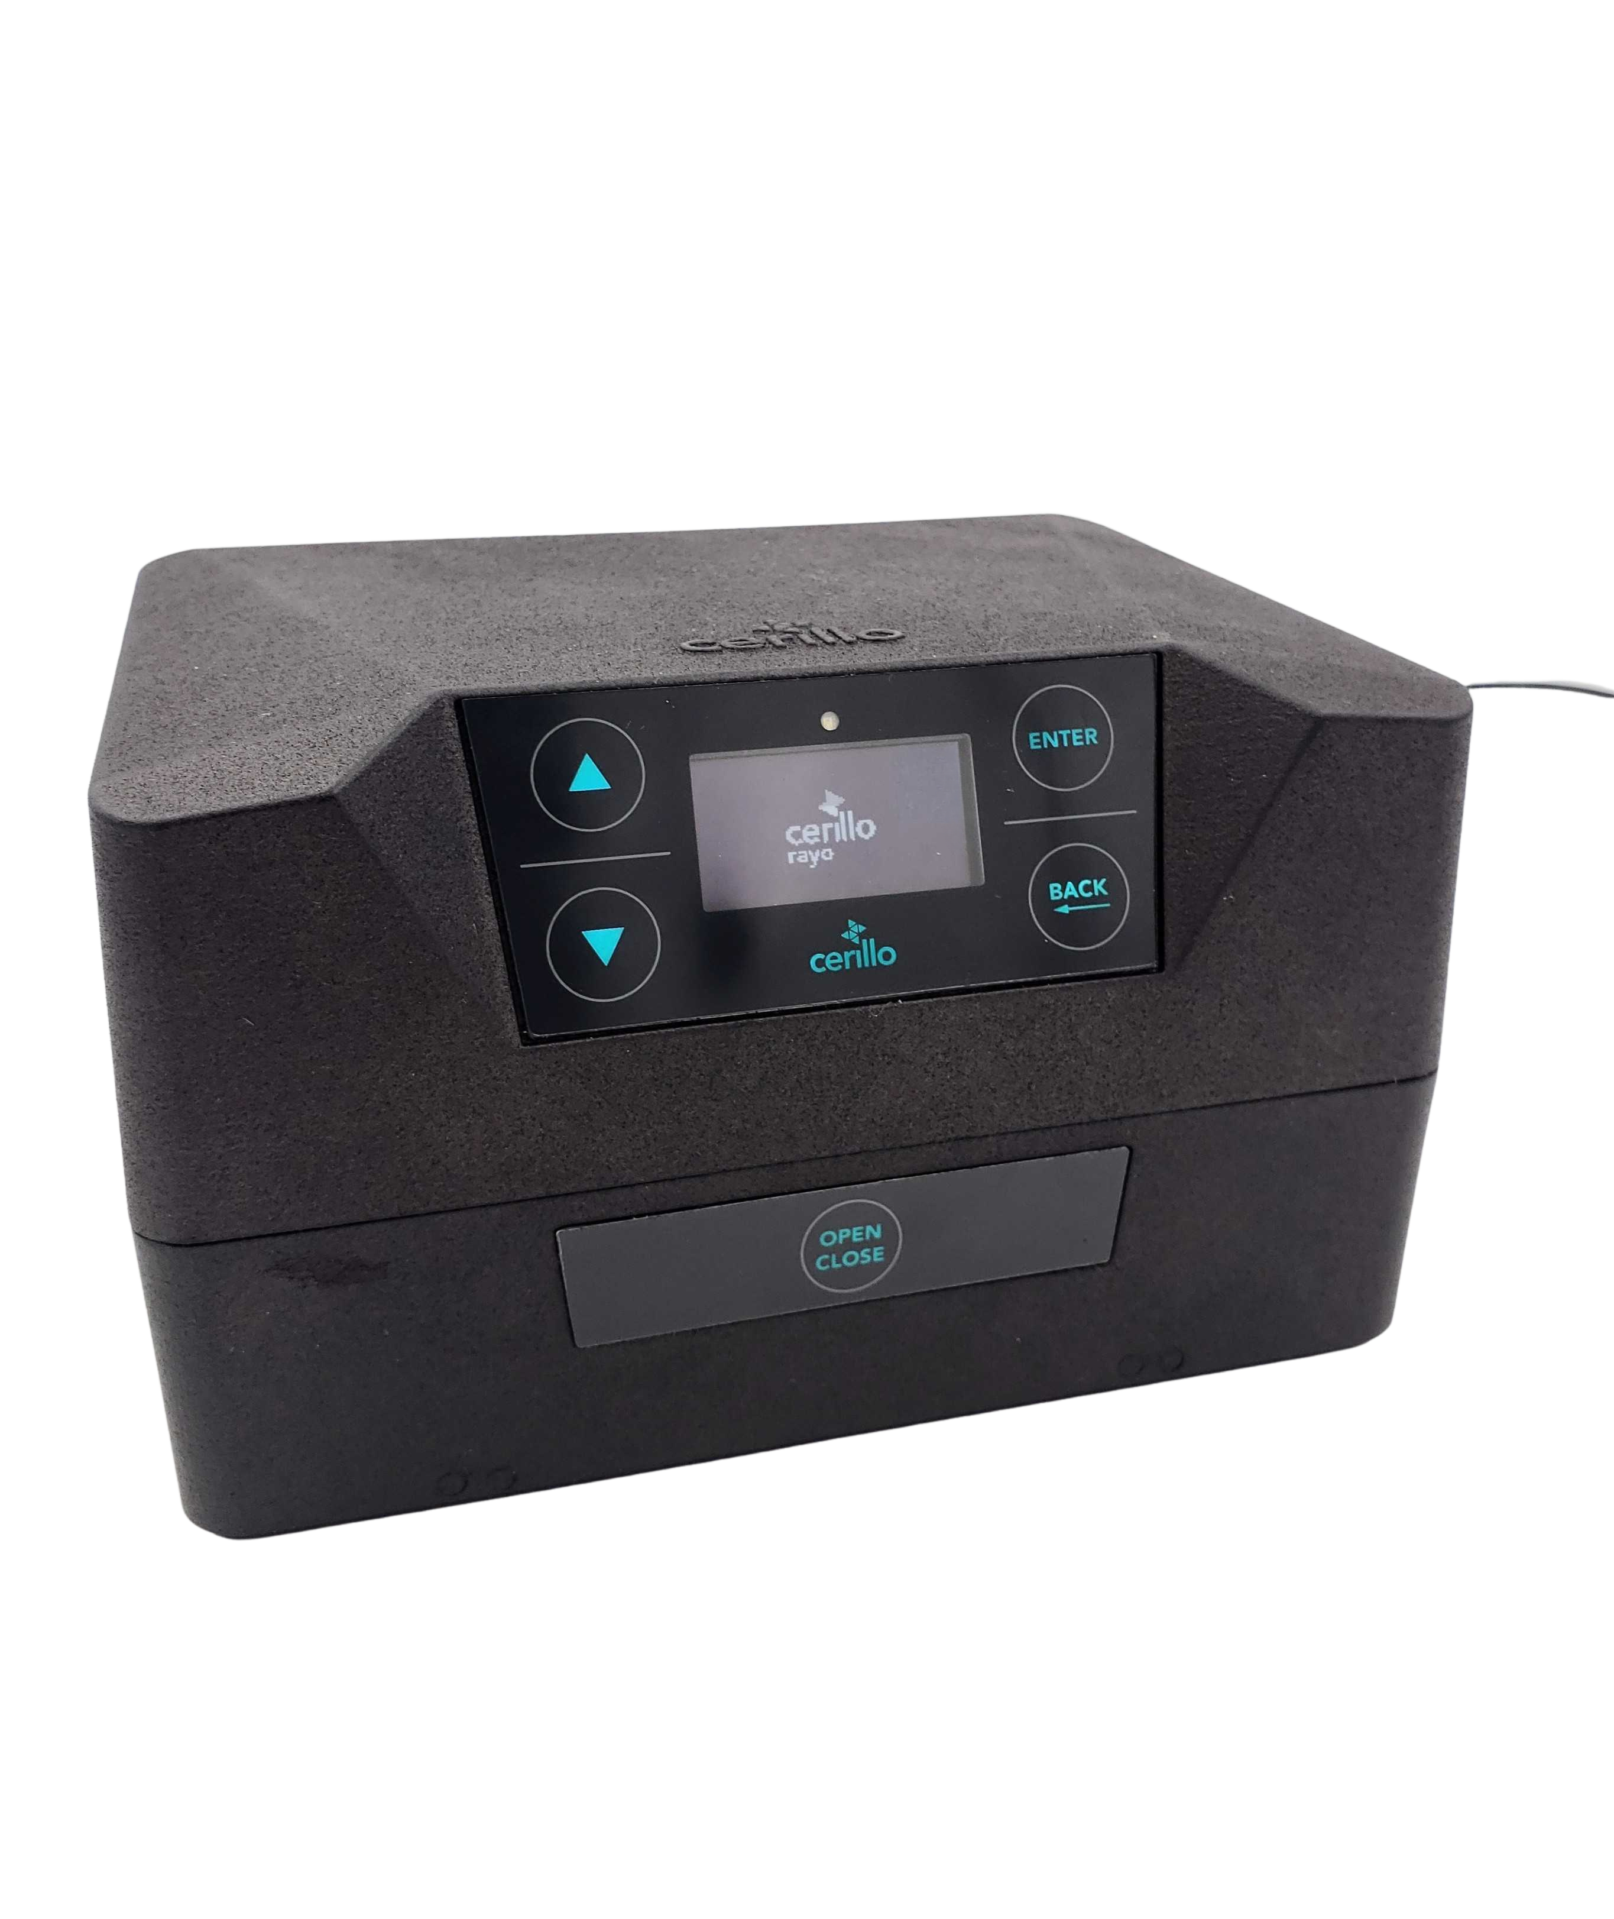
RAYO — The Future of Microplate Readers
Customer Feedback Shapes Products to Meet Real-World Needs
Multiwavelength Microplate Readers of the Future.
A new suite of options and applications for the patented Cerillo plate reader!
  Four wavelengths in a single device
  Fits on-deck and integrates with multiple liquid handlers
  Control screen with buttons on front of hardware
  Proprietary clamshell model remains
  Fits 6-, 12-, 96-well plates, plus Duet System
  Maintains anaerobic, temperature, and humidity expectations of Cerillo plate reader customers
  The final frontier of absorbance-based measurement technologies.
The Market Talked.
We Listened. We Heard. We Delivered.
2025 Cerillo - Confidential and Proprietary
Notes:
Stronger Value Proposition – Offer compliant, validated tools pharma customers need
Sales Differentiator – Stand out with built-in features like audit trails and secure access
Regulatory Confidence – Help customers meet FDA requirements with ease
Faster Procurement – Pre-validated systems reduce onboarding friction
Long-Term Loyalty – Trusted compliance builds credibility and repeat business

Slide 8

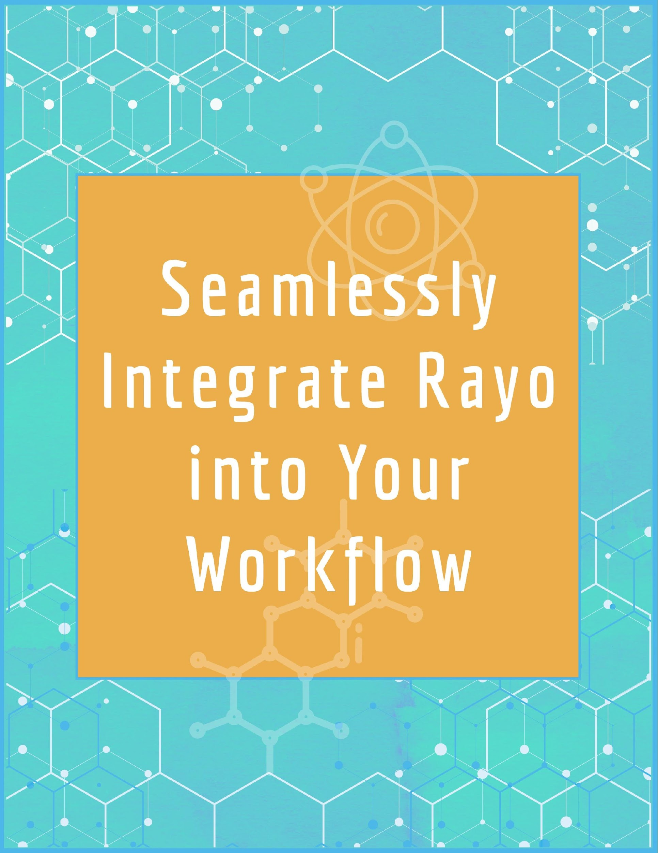

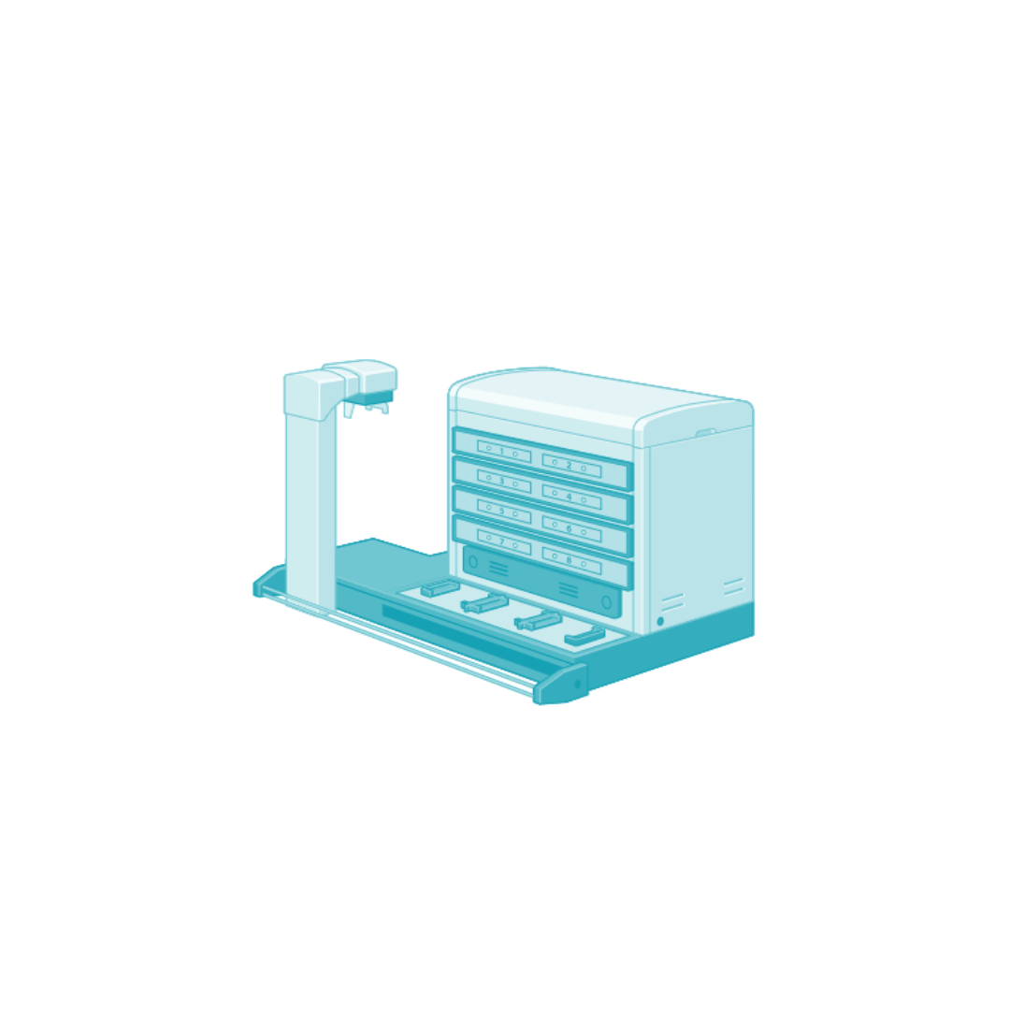



Automated Workflow Examples
ELISA Assay
Culture Normalization
Therapeutic Development
Biological Growth and Sampling
Dispense Validation
Cell Viability Assay
2025 Cerillo - Confidential and Proprietary

Slide 9
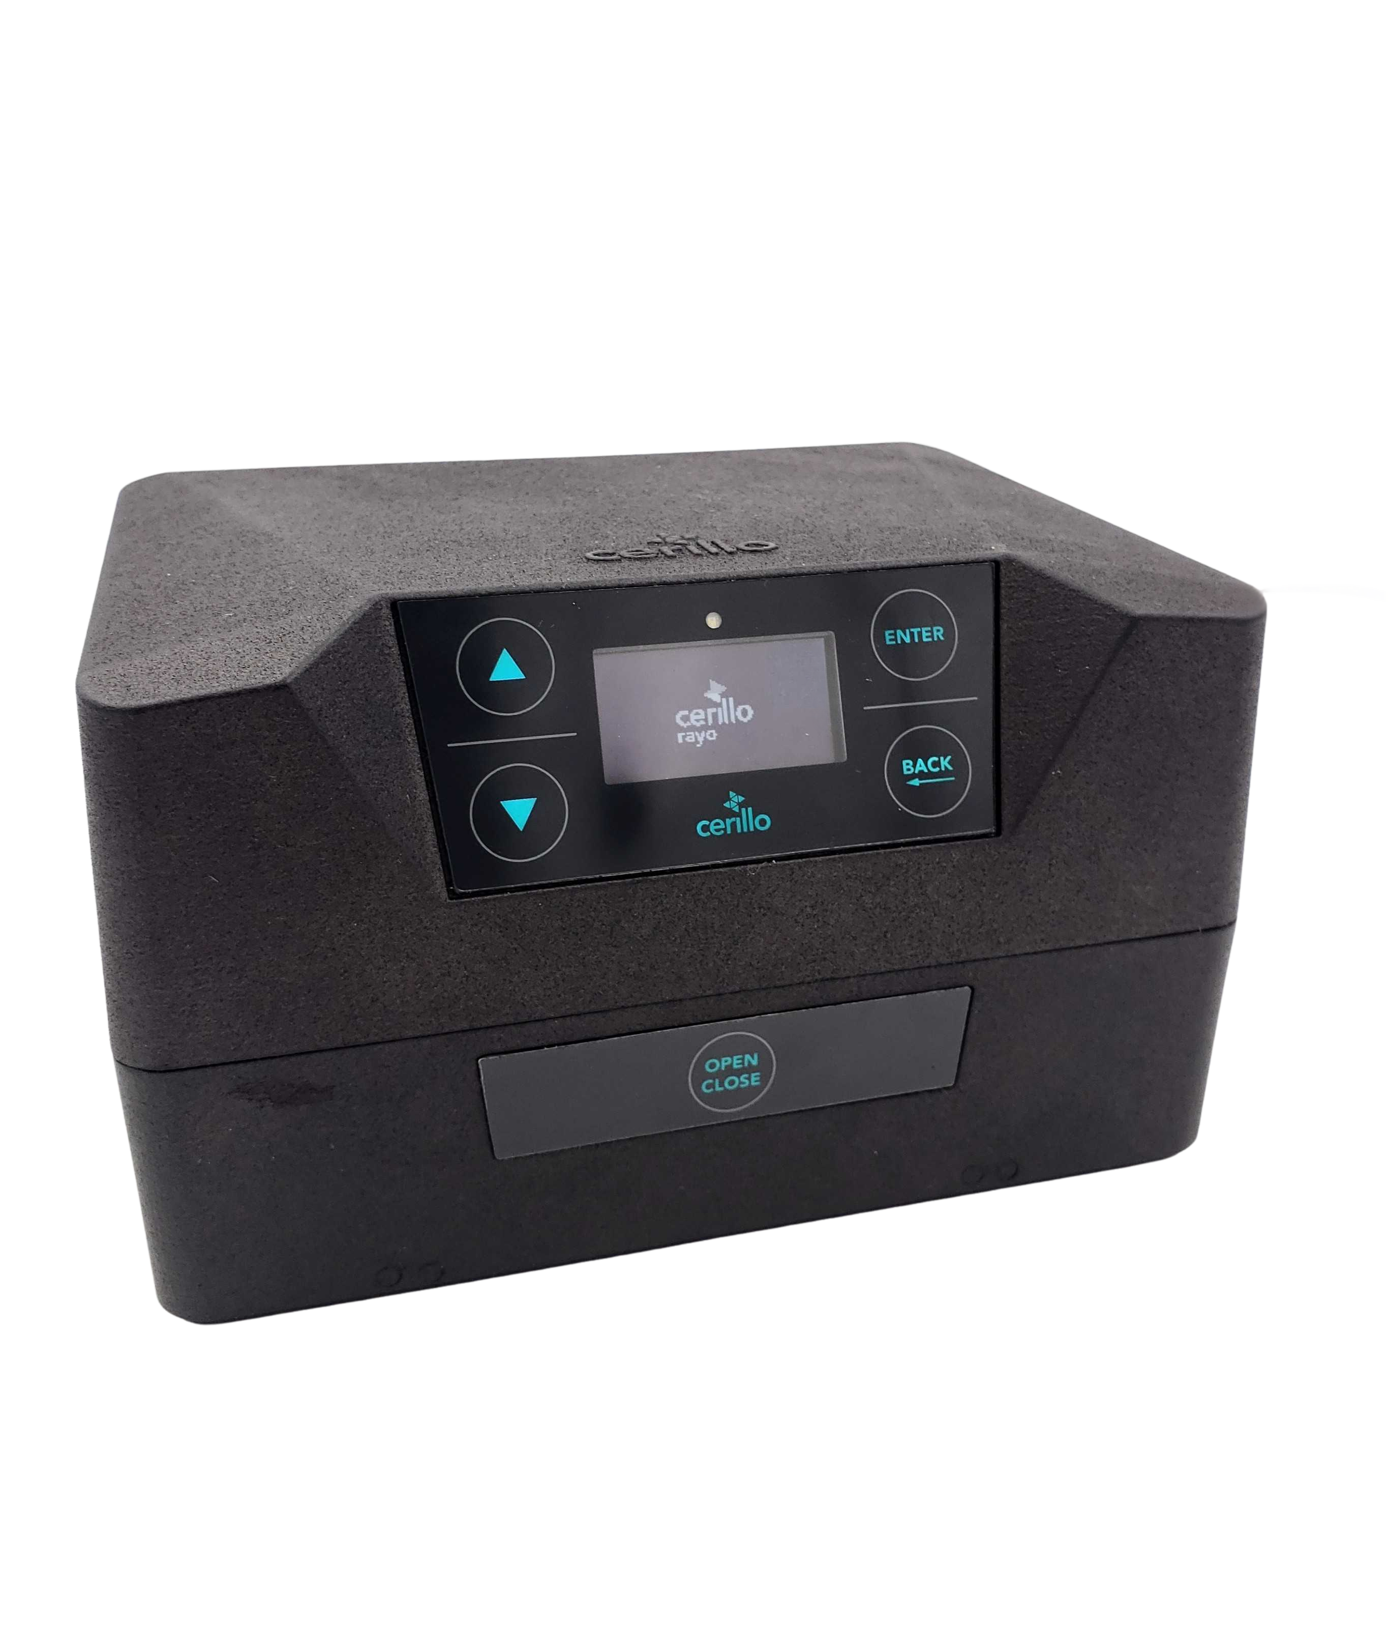
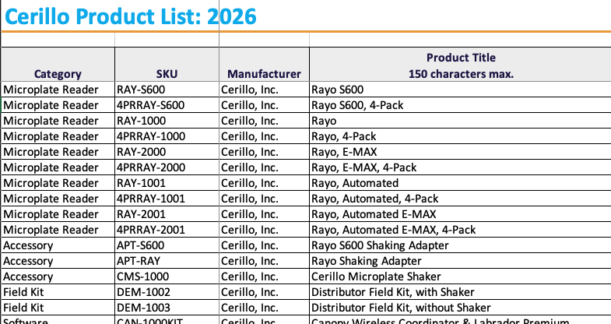
THE RAYO: Model Numbers
Multiple Models Under “RAYO” Branding
The Market Talked.
We Listened. We Heard. We Delivered.
2025 Cerillo - Confidential and Proprietary
Notes:
Stronger Value Proposition – Offer compliant, validated tools pharma customers need
Sales Differentiator – Stand out with built-in features like audit trails and secure access
Regulatory Confidence – Help customers meet FDA requirements with ease
Faster Procurement – Pre-validated systems reduce onboarding friction
Long-Term Loyalty – Trusted compliance builds credibility and repeat business

Slide 10
RAYO: Model Numbers for Non-Automated Versions
Multiple Models Under “RAYO” Branding
Model Name | RAYO S600 | RAYO | RAYO: EMAX
SKU | RAY-S600 | RAY-1000 | RAY-2000
Wavelengths | 600nm | 405nm, 450nm, 590nm, 740nm | 405nm, 450nm, 490nm, 590nm
Price | $5,495 | $9,999 | $9,999
Shaker Adaptor SKU | APT-S600 | APT-RAY | APT-RAY
The Market Talked.
We Listened. We Heard. We Delivered.
2025 Cerillo - Confidential and Proprietary
Notes:
Stronger Value Proposition – Offer compliant, validated tools pharma customers need
Sales Differentiator – Stand out with built-in features like audit trails and secure access
Regulatory Confidence – Help customers meet FDA requirements with ease
Faster Procurement – Pre-validated systems reduce onboarding friction
Long-Term Loyalty – Trusted compliance builds credibility and repeat business

Slide 11
RAYO: Model Numbers for Automated Versions
RAYO S600 is NOT available for automation integration
Model Name | RAYO S600 | RAYO | RAYO: EMAX
SKU | N/A | RAY-1001 | RAY-2001
Wavelengths | N/A | 405nm, 450nm, 590nm, 740nm | 405nm, 450nm, 490nm, 590nm
Price | N/A | $14,999 | $14,999
Liquid Handler Adapter SKU | N/A | VARIES BY ROBOTIC SYSTEM | VARIES BY ROBITIC SYSTEM
The Market Talked.
We Listened. We Heard. We Delivered.
2025 Cerillo - Confidential and Proprietary
Notes:
Stronger Value Proposition – Offer compliant, validated tools pharma customers need
Sales Differentiator – Stand out with built-in features like audit trails and secure access
Regulatory Confidence – Help customers meet FDA requirements with ease
Faster Procurement – Pre-validated systems reduce onboarding friction
Long-Term Loyalty – Trusted compliance builds credibility and repeat business

Slide 12
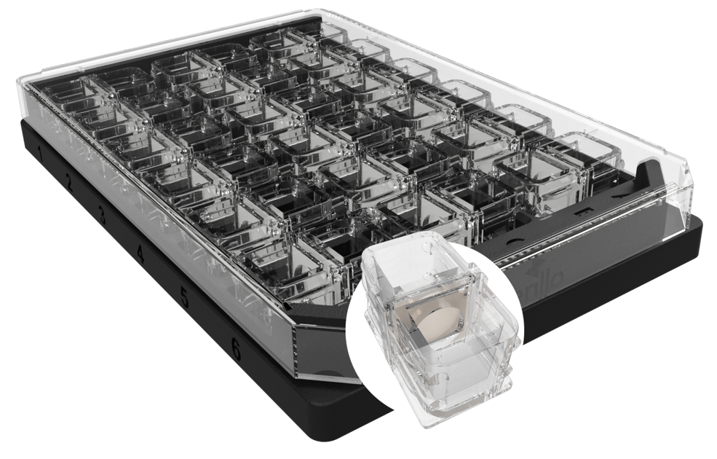
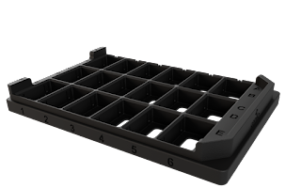
Duet Co-Culture Systems
World’s First Standardized, Consumable Technology for Microbial Interactions
Duet
Co-Culture
Plates
Up to 18 Duets
1 Duet = 2 Reservoirs / 1 Membrane
Reservoir Volume: 800µL
Polycarbonate Material
Treated with PVP
Pore Size: 0.2µm, 0.05µm
Membrane Thickness: 25µm
1.52 cm tall microplate (~1.75 cm with a lid)
Drive Decisions
Enhance Reliability
Reduce Risk
2025 Cerillo - Confidential and Proprietary

Slide 13
Duet Co-Culture: Mammalian Model
Customer Feedback Shapes Products to Meet Real-World Needs
Mammalian Duet Systems
(0.2µm membranes)
Cerillo’s proven duet systems, but for eukaryotic cellular interactions
  Plasma etching on bottom of duet for cell adhesion
  Uses same membranes (0.2µm) as Microbial Duets
  Same format as Microbial Duet Co-Culture System (18 duets per tray)
  Trays can be mixed with other duet types for experimental flexibility
    Automation friendly
  Can be purchased in samples, trays, refill bags, and bundles
  Mammalian co-culture experiments in an easy, ready-to-use system. Complete experimental flexibility.
Users Talked.
We Listened. We Heard. We Delivered.
2025 Cerillo - Confidential and Proprietary
Notes:
Stronger Value Proposition – Offer compliant, validated tools pharma customers need
Sales Differentiator – Stand out with built-in features like audit trails and secure access
Regulatory Confidence – Help customers meet FDA requirements with ease
Faster Procurement – Pre-validated systems reduce onboarding friction
Long-Term Loyalty – Trusted compliance builds credibility and repeat business

Slide 14
Introducing Maulik Oza
Cerillo’s Commercial Vice Present, focused on Marketing and Sales Enablement
20 Years of BioTools Commercialization Experience
Meet Your
Cerillo Team
Began at Cerillo since December 2024
Will serve as an additional (not replacing Eric) commercial resource for partners
Maulik Oza
VP, Commercial
2025 Cerillo - Confidential and Proprietary

Slide 15

Sales and Support Model
Cerillo Partner Portal
Training Videos and materials covering all Cerillo tools and software
Application-specific use cases (e.g., anaerobic research, phage-microbe co-culture)
Sales Enablement Tools
Product brochures and technical data sheets
Slide decks and demo videos
Marketing Support
Collateral
Campaigns and lead generation assets
Access to case studies and customer testimonials
Technical Support
Setup and troubleshooting assistance
Demo Field Kit
Access systems for customer demonstrations
Territory & Account Strategy
Shared pipeline reviews and sales planning
Pricing strategy guidance
Product update briefings
Application training as new features or tools launch
Product Training
Ongoing Education
2025 Cerillo - Confidential and Proprietary

Slide 16
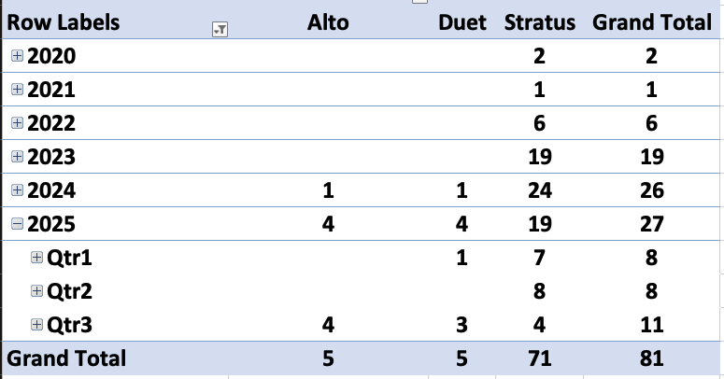
Sales and Support Model: User Publications
Peer Reviewed Publications Citing Cerillo Products is Dramatically Increasing
Large (expected) increase in user publications.
Will continue throughout 2026!!
Internal monthly monitoring of new publication citations
Links are available
(by product) on the Cerillo website. Full PDFs available by specific request.
2025 Cerillo - Confidential and Proprietary

Slide 17






Automated Workflow – ELISA Assay
Sample Protocol for Immunology and Proteomics Development
Transfer capture antibody solution to each well of a microplate using liquid handler.
Cover plate and incubate.
Wash the plate using liquid handler or automated plate washer to remove unbound capture antibody.
Transfer blocking buffer to each well to prevent non-specific binding of subsequent reagents.
Cover and incubate the plate.
Wash the plate multiple times using liquid handler or automated plate washer to remove unbound capture antibody.
Transfer samples and standards to the wells using liquid handler.
Incubate to allow the target antigen in the sample to bind to the immobilized capture antibody.
Wash the plate using liquid handler or automated plate washer to remove unbound samples and standards.
Transfer the primary detection antibody to the wells using a liquid handler.
Incubate to allow the detection antibody to bind to a different epitope on the antigen.
Wash the plate using liquid handler or automated plate washer to remove unbound detection antibody.
Transfer enzyme-conjugated secondary antibody. Binds to detection antibody w/automated liquid handler.
Wash the plate using liquid handler or automated plate washer to remove unbound detection antibody.
Transfer substrate solution to each well using automated liquid handler.
Calibrate the Rayo plate reader while empty.
Place plate in Rayo plate reader using gripper.
Incubate according to ELISA kit instructions. Absorbance measurements can be collected at any point throughout incubation.
Rayo Enhances Reliability
Rayo Automates Workflow
Add a stop solution to stop the enzymatic reaction using the automated liquid handler.
Use Rayo automation to close plater reader via seamlessly integrated API
Collect absorbance at a specific wavelength.
BACK TO ALL WORKFLOWS>
Rayo Enhances Reliability

Slide 18


Automated Workflow – Therapeutic Development
Sample Protocol for Drug Dosing and MIC for Antimicrobial Resistance
Transfer cells from bulk culture to unlidded plate using automated pipettor; plate likely located on deck to reduce contamination risk
Either calibrate Rayo while empty or generate calibration for each starting culture
Use Rayo automation to open plate reader via seamlessly integrated API
Lid plate and transfer to Rayo using gripper
Use Rayo automation to close plater reader via seamlessly integrated API
Rayo Enhances Reliability
Rayo Enhances Reliability
Rayo Enhances Reliability
Rayo Enhances Reliability
Collect starting OD measurement
Use Rayo automation to open plate reader via seamlessly integrated API
Transfer plate to incubator or plate hotel using gripper
Repeat steps 3-8, cycling through all experimental plates
Call Rayo calibration corresponding to plate, if applicable
Rayo Enhances Reliability
Rayo Enhances Reliability
After culture reaches target OD, transfer therapeutic to wells at target concentration
Continue repeating steps 3-8, cycling through all experimental plates
Periodically transfer plate to Rayo for OD measurement -Option to use automated pipettor to collect biological samples for plating, genomics, metabolomics, LC-MS, or other downstream analysis
Rayo Enhances Reliability
BACK TO ALL WORKFLOWS>

Slide 19
New Product Commercial Implications
PARTNER TAKEAWAY
Cerillo is enabling our partners to sell more products, to a expanded audience, and at a higher price point.
WIN – WIN – WIN FOR PARTNERS, CERILLO, AND CUSTOMERS
2025 Cerillo - Confidential and Proprietary

Slide 20

Please Send Availabilities for Review Call in late October/Early Nov
Let’s advance cellular research—together.
Website: cerillo.bio
Partner Portal: https://cerillo.bio/partner-portal/
Password: cerillopartner23
sales@cerillo.bio
Sales Support Questions
support@cerillo.bio
Product Technical Support
(AFTER checking website & online Help Center)
orders@cerillo.bio
Submission of Purchase Orders
Eric Mayton
Chief Executive Officer
eric@cerillo.bio
Maulik Oza
VP, Commercial
maulik@cerillo.bio
2025 Cerillo - Confidential and Proprietary

Slide 21
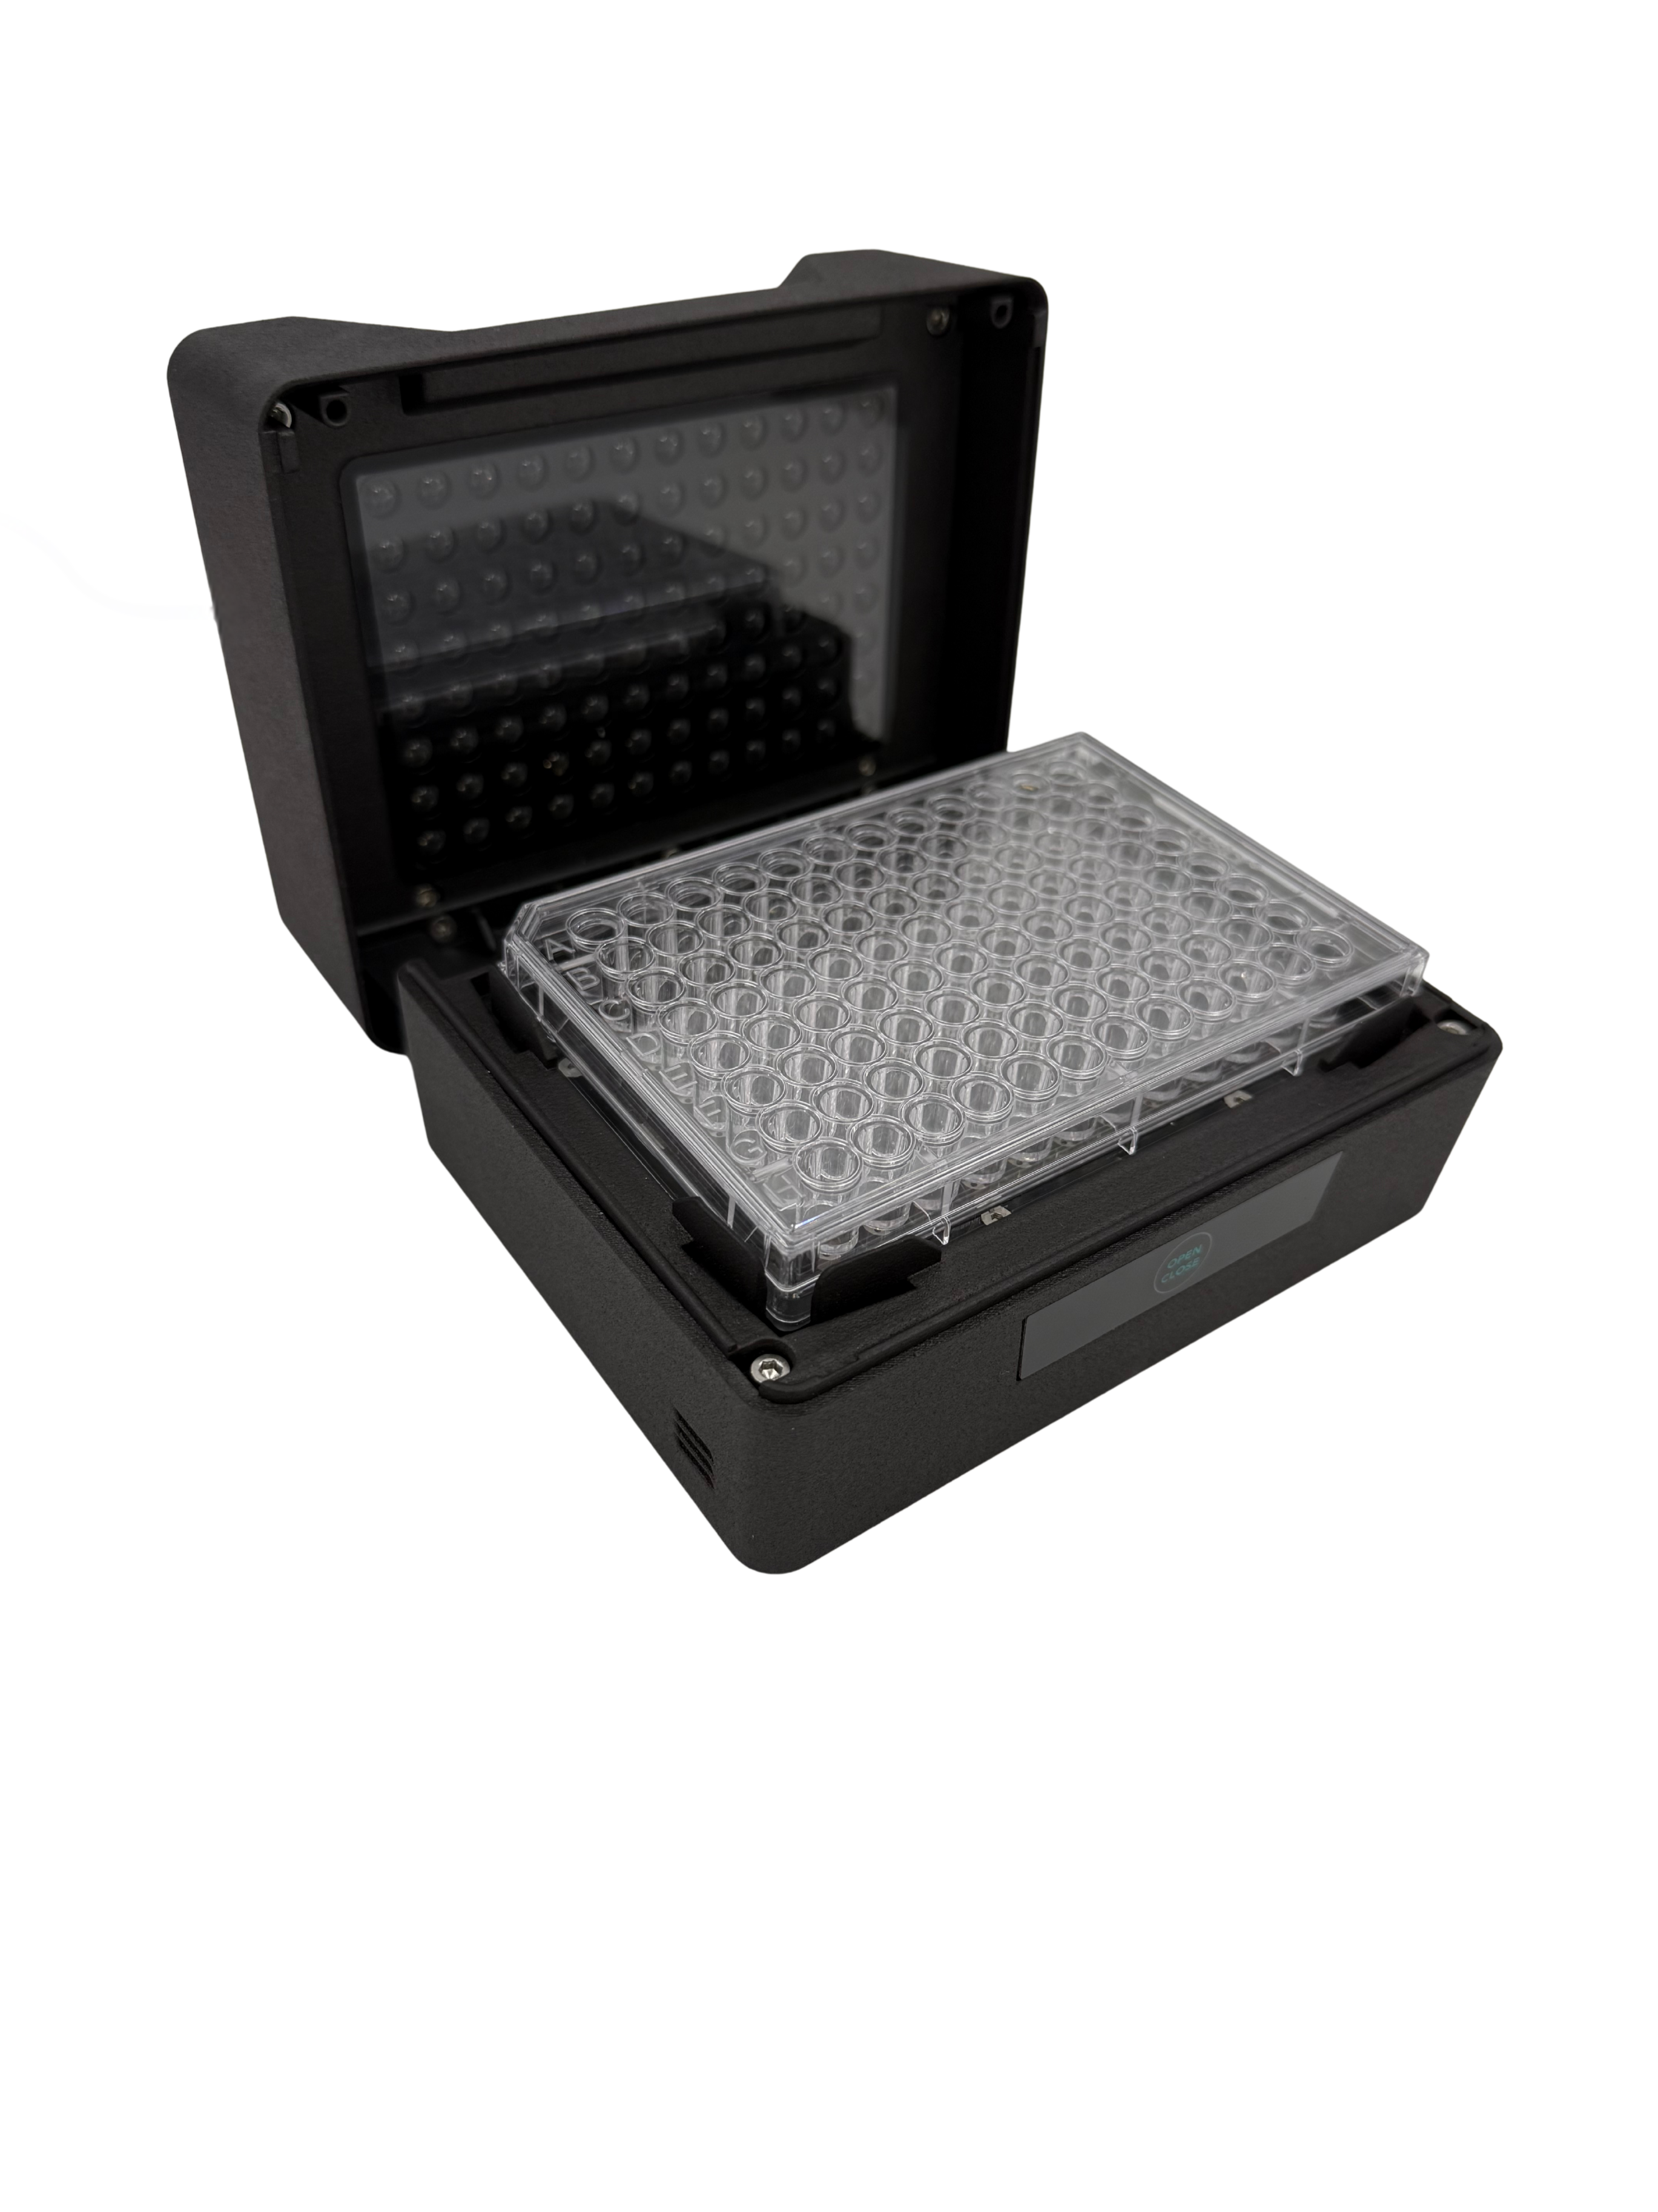
RAYO — The Future of Microplate Readers
Drive Decisions
Increase Mobility
Enhance Reliability
Save Time
Miniaturized, Personal Plate Reader
10x Smaller than traditional competitors
Works in ANY environment
Continuously collect unlimited data points
Kinetic and Endpoint Measurements
Multiple models to fit user needs
Fits 6, 12, and 96-well plates, as well as the Duet Co-Culture plate
Operates within most environments
      Heat (up to 50C)
      Shaking (Shaker Adapter accessory)
      Anaerobic Conditions (Corrosion Resistant)
2025 Cerillo - Confidential and Proprietary

Slide 22
Duet Co-Culture: Phage Model
Customer Feedback Shapes Products to Meet Real-World Needs
Phage (0.05µm) Duet Systems
Cerillo’s proven duet systems with modification for phage researchers
  Same format as Microbial Duet Co-Culture System (18 duets per tray)
  Trays can be mixed with other duet types for experimental flexibility
    Automation friendly
  Can be purchased in samples, trays, refill bags, and bundles
  Phage co-culture experiments in an easy, ready-to-use system. Complete experimental flexibility.
Users Talked.
We Listened. We Heard. We Delivered.
2025 Cerillo - Confidential and Proprietary
Notes:
Stronger Value Proposition – Offer compliant, validated tools pharma customers need
Sales Differentiator – Stand out with built-in features like audit trails and secure access
Regulatory Confidence – Help customers meet FDA requirements with ease
Faster Procurement – Pre-validated systems reduce onboarding friction
Long-Term Loyalty – Trusted compliance builds credibility and repeat business

Slide 23
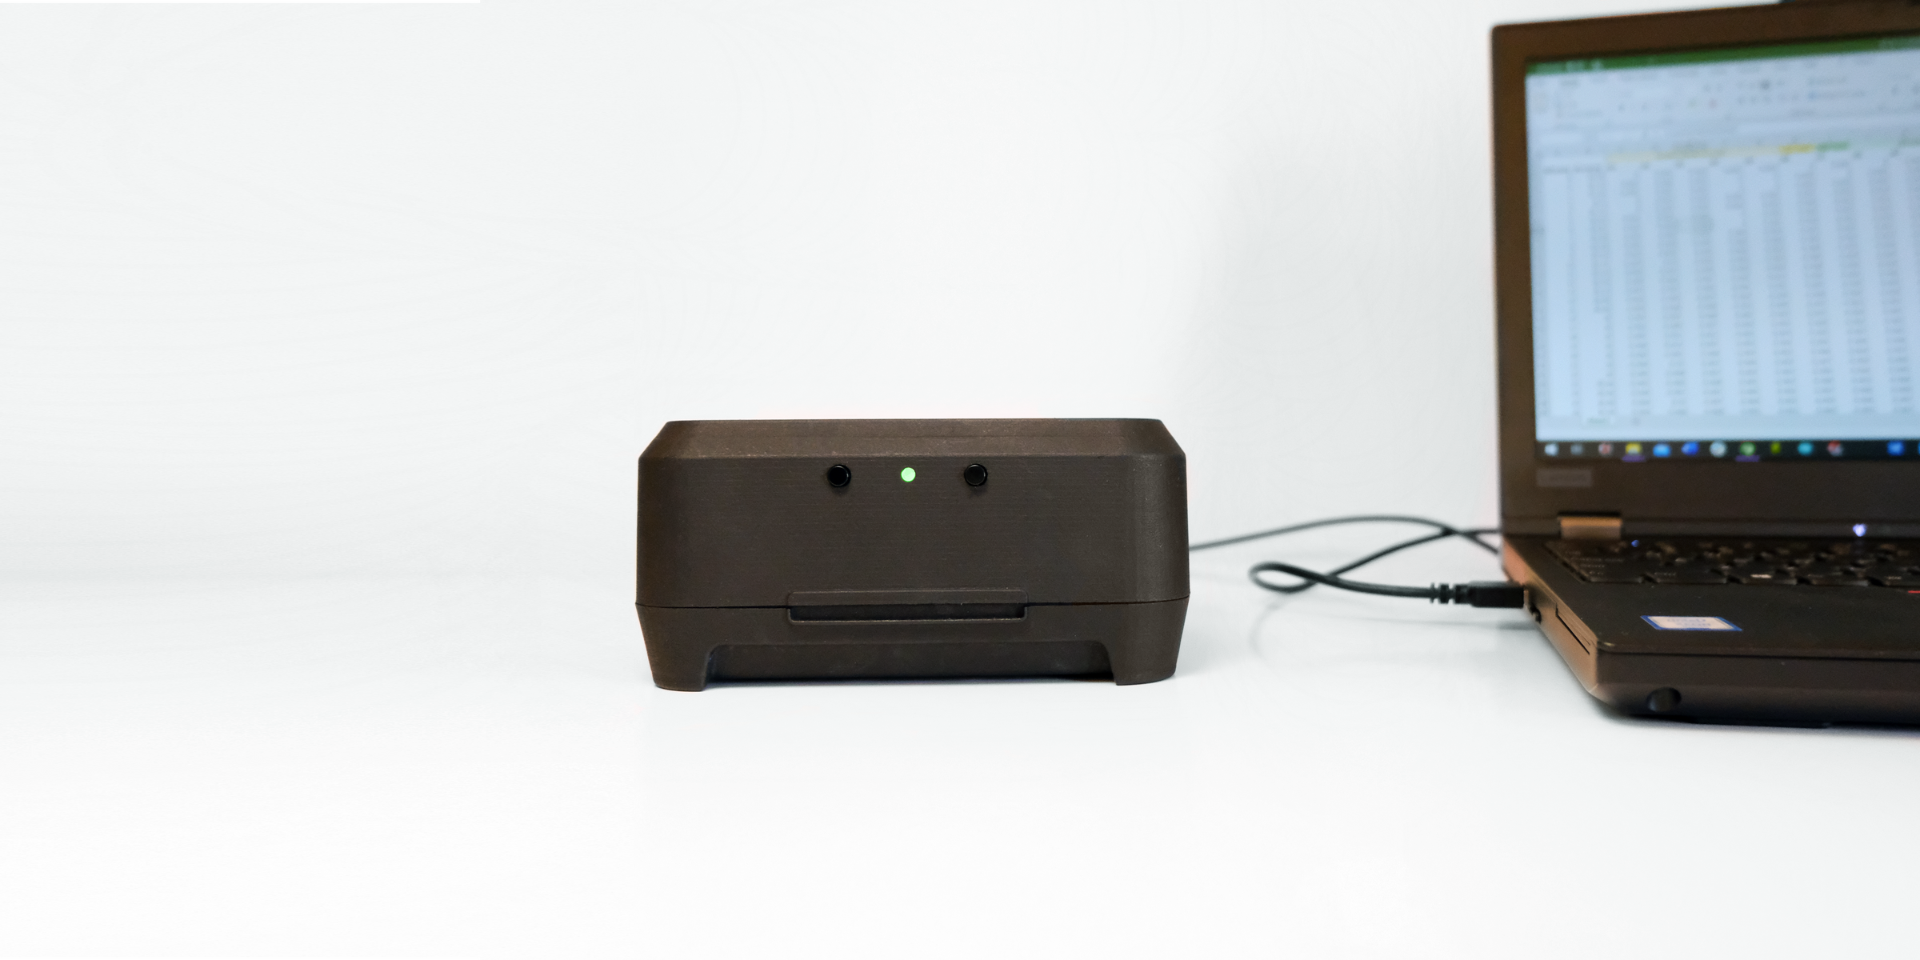
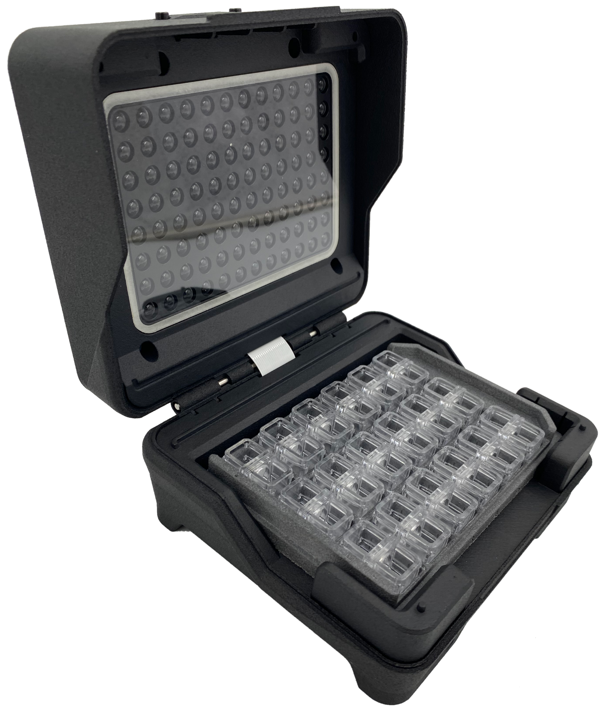
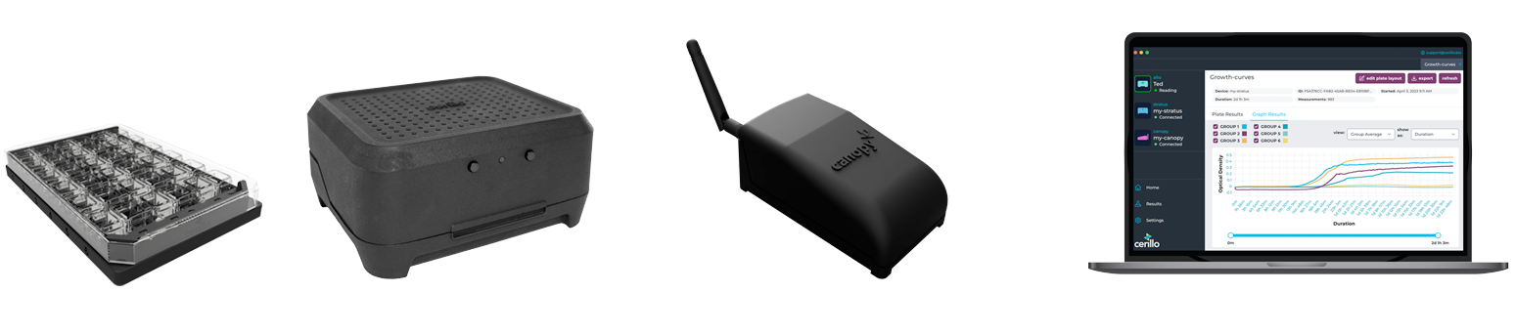
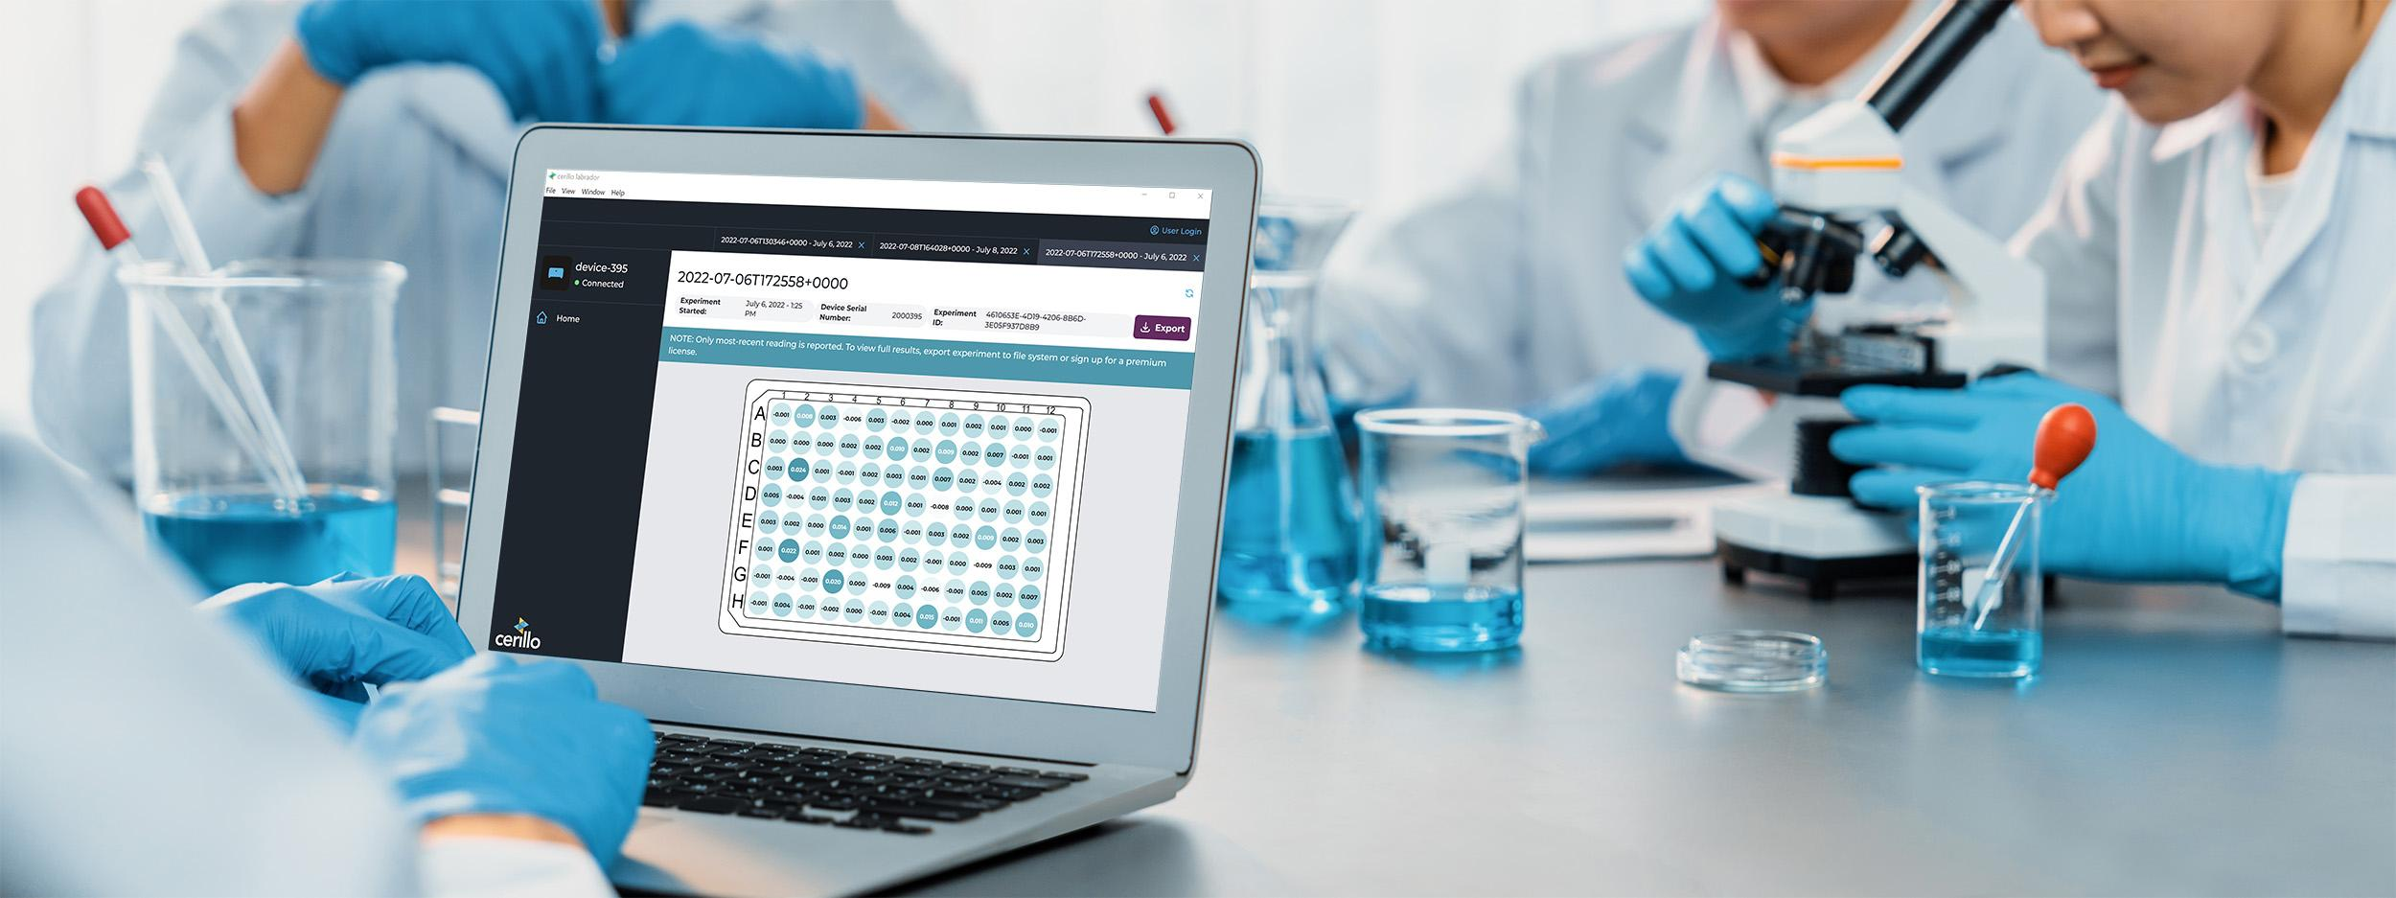
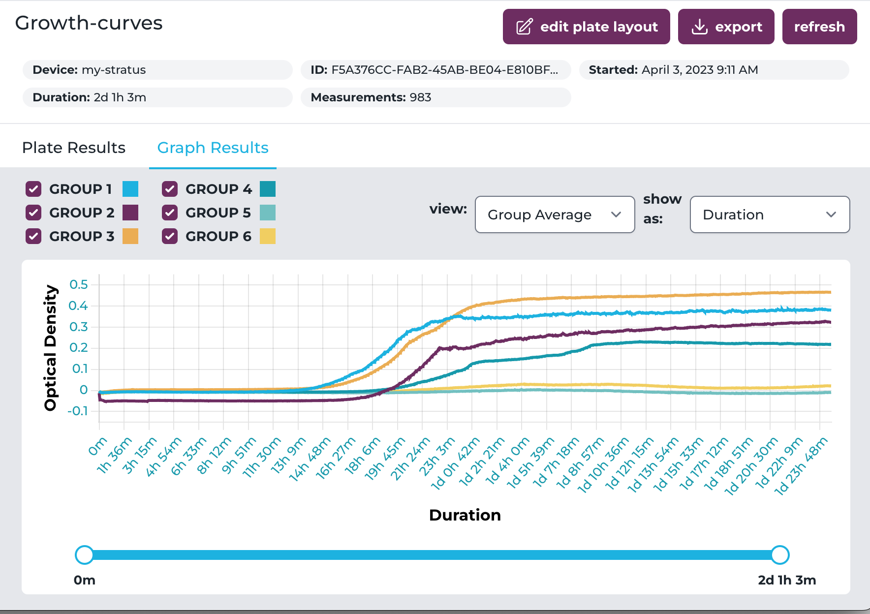
Labrador Software One Platform Two Paths to Discovery
Labrador Standard
Ideally suited for researchers who are in lab and do not require remote access
Labrador Premium + Canopy
Designed for users who benefit from real-time data and wireless access.
Drive Decisions
Enhance Reliability
Save Time
2025 Cerillo - Confidential and Proprietary
Notes:
Labrador Standard
Ideally suited for researchers who are in lab and do not require remote access
Labrador Premium + Canopy
Designed for users who are in the field and require wireless remote access.

Slide 24
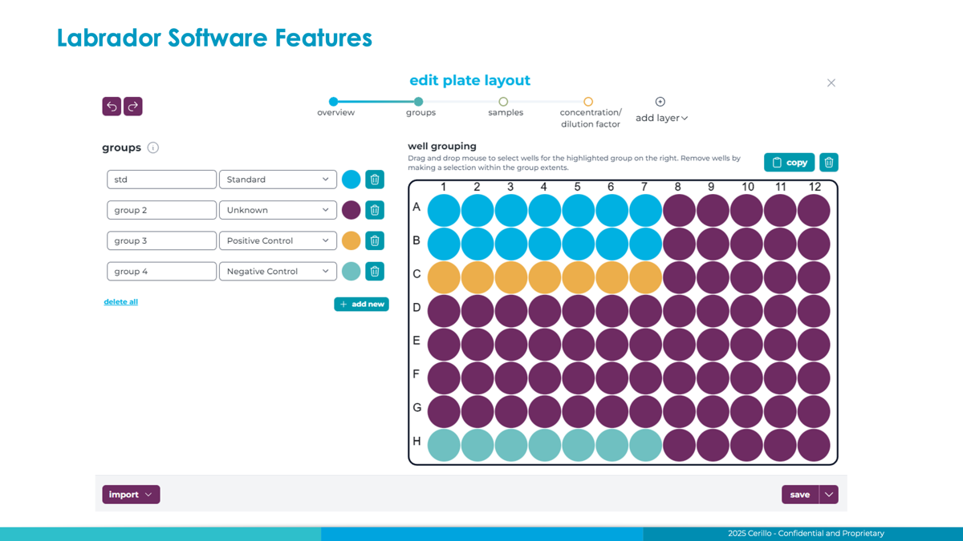
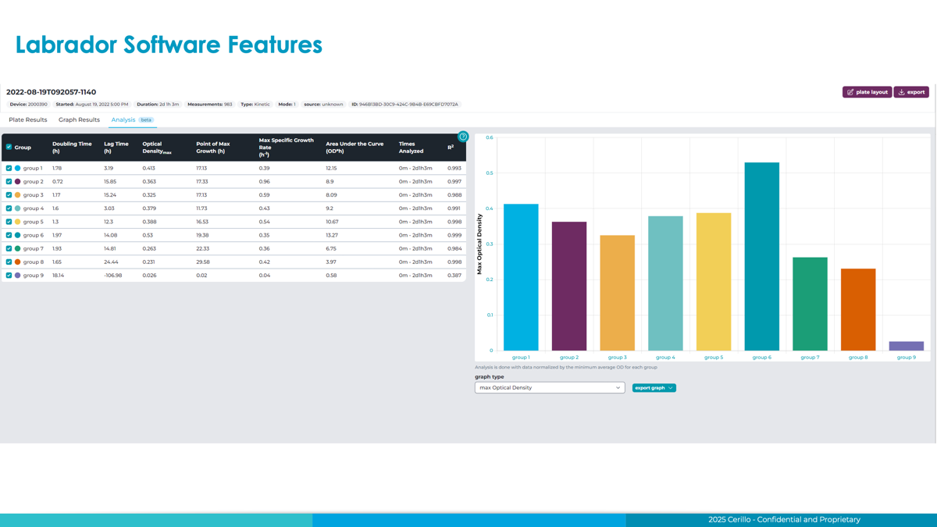
Upgrade to Labrador Premium + Canopy*
“
We love Labrador. Can you please
open it to non-Cerillo data as soon as possible?”
Researcher from Harvard/MIT/Boston Children’s Hospital
Experience the freedom to bring your research anywhere.
Remote start/stop with set durations reduces manual steps
Live-stream growth data offers real-time insight
Wireless data via Canopy lets you remotely monitor experiments
Single interface controls multiple devices at once
5 user seats (expandable) enable team access
Use software on any computer without special setup—
Saves time, improves consistency, and accelerates research.
Enables quick decisions and early issue detection.
Supports remote work, increases mobility, and avoids lab disruptions.
Increases mobility and flexibility across locations.
Supports collaboration and shared workflows across labs.
Boosts productivity and simplifies complex experiments.
*License Fee
  Annual License: Includes Automatic Software updates.
One Time Software Purchase: Does not include automatic software updates. Will remain at current version at time of purchase. Includes bug fixes
2025 Cerillo - Confidential and Proprietary

Slide 25


Upgrade to Labrador Premium + Canopy
Enjoy Labrador Standard’s Robust Features
Automatic interval setting and smart data analysis tool
Add Premium + Canopy to Unlock Wireless Freedom
Real-time access and effortless data handling anywhere you work
Labrador Standard
Labrador Premium+Canopy
License Fee
  Annual License: Includes automatic software updates.
One Time Software Purchase:
Will remain at current version at time of purchase. Includes bug fixes
Remote start and automatic stop duration setting
Live stream growth measurements
Remote data transmission using canopy
Control multiple devices at once.
5 user seats included (can purchase additional seats)
Use software on any computer
Included FREE with device
Manual start and stop
Connect device to computer or extract data from microSD card.
FEATURES OF BOTH PACKAGES:
Automatic
Interval Setting
Data Analysis Tool
Export raw data as CSV, excel file.
Automatic data saving to microSD card.
2025 Cerillo - Confidential and Proprietary

